Slide 1
CSC8631 Coursework
Data Management and Exploratory Data Analysis

Slide 2
Popper (The logic of Scientific Discovery)
“
“Non-reproducible single occurrences are of no significance to science”

Slide 3
Git
Version Control System

Slide 4

Git Branching Model

Slide 5
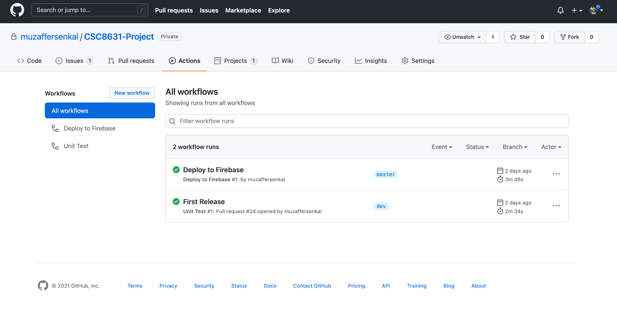


Github Actions
Pull Request on Dev Branch
Merge on Master Branch
https://datamanagement-4be96.web.app
Notes:
Multi disipliner

Slide 6
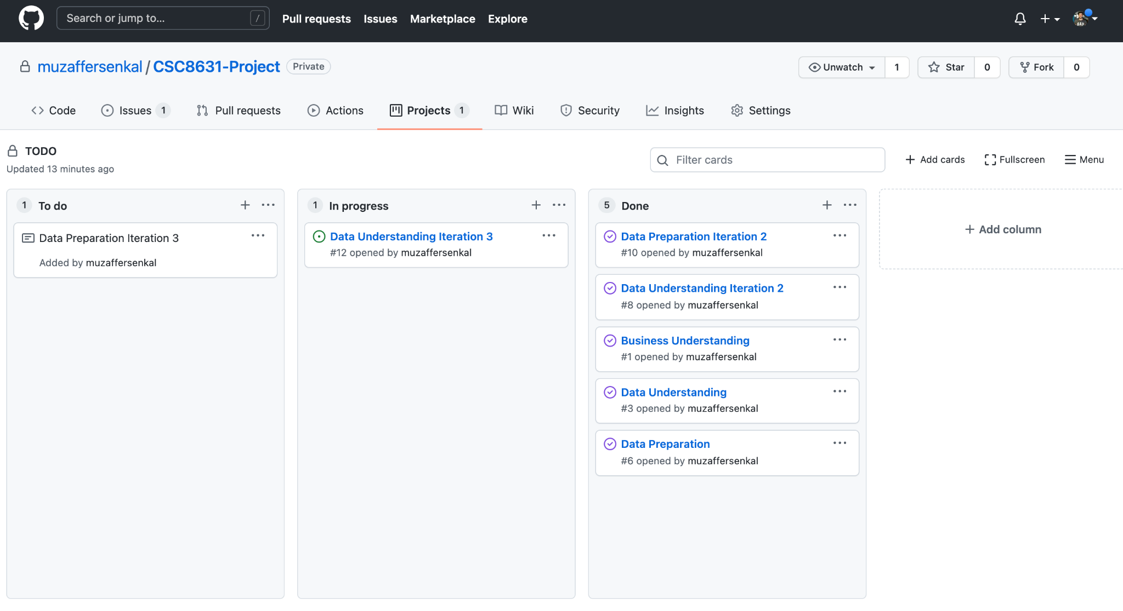
Agile Methodology - Kanban

Slide 7
CRISP-DM
Methodology

Slide 8
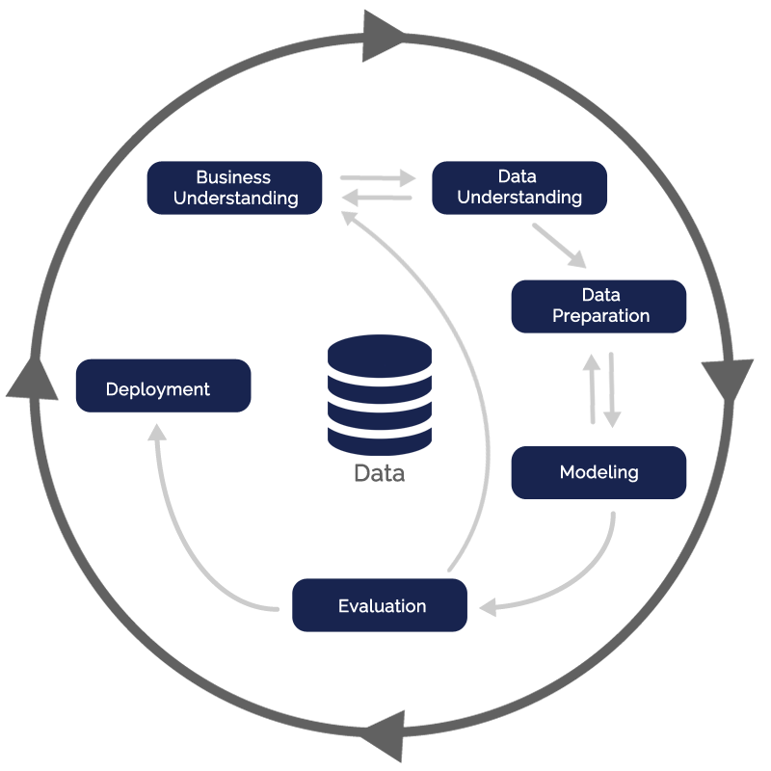
Steps

Slide 9
Business Understanding

Slide 10
Estimated Reading Time
Businesses are making effort to achieve an edge with its content marketing program. Showing an article’s reading time to each of article can have a profound and positive effect on reader engagement levels.

Slide 11
Evidence
“
“I know that watching the film Pulp Fiction will take me exactly 154 minutes, and this doesn’t change anything to the fact that it’s an awesome film and that I will have a great time watching it. Knowing in advance how long an article will take me just helps me with my time management, by allowing me to plan better.”

Slide 12
Business Objectives
how the reading time of the articles changes according to learners
Develop a model that can predict the average article reading time for each person
Notes:
fatura

Slide 13
Exploratory Data Analysis

Slide 14
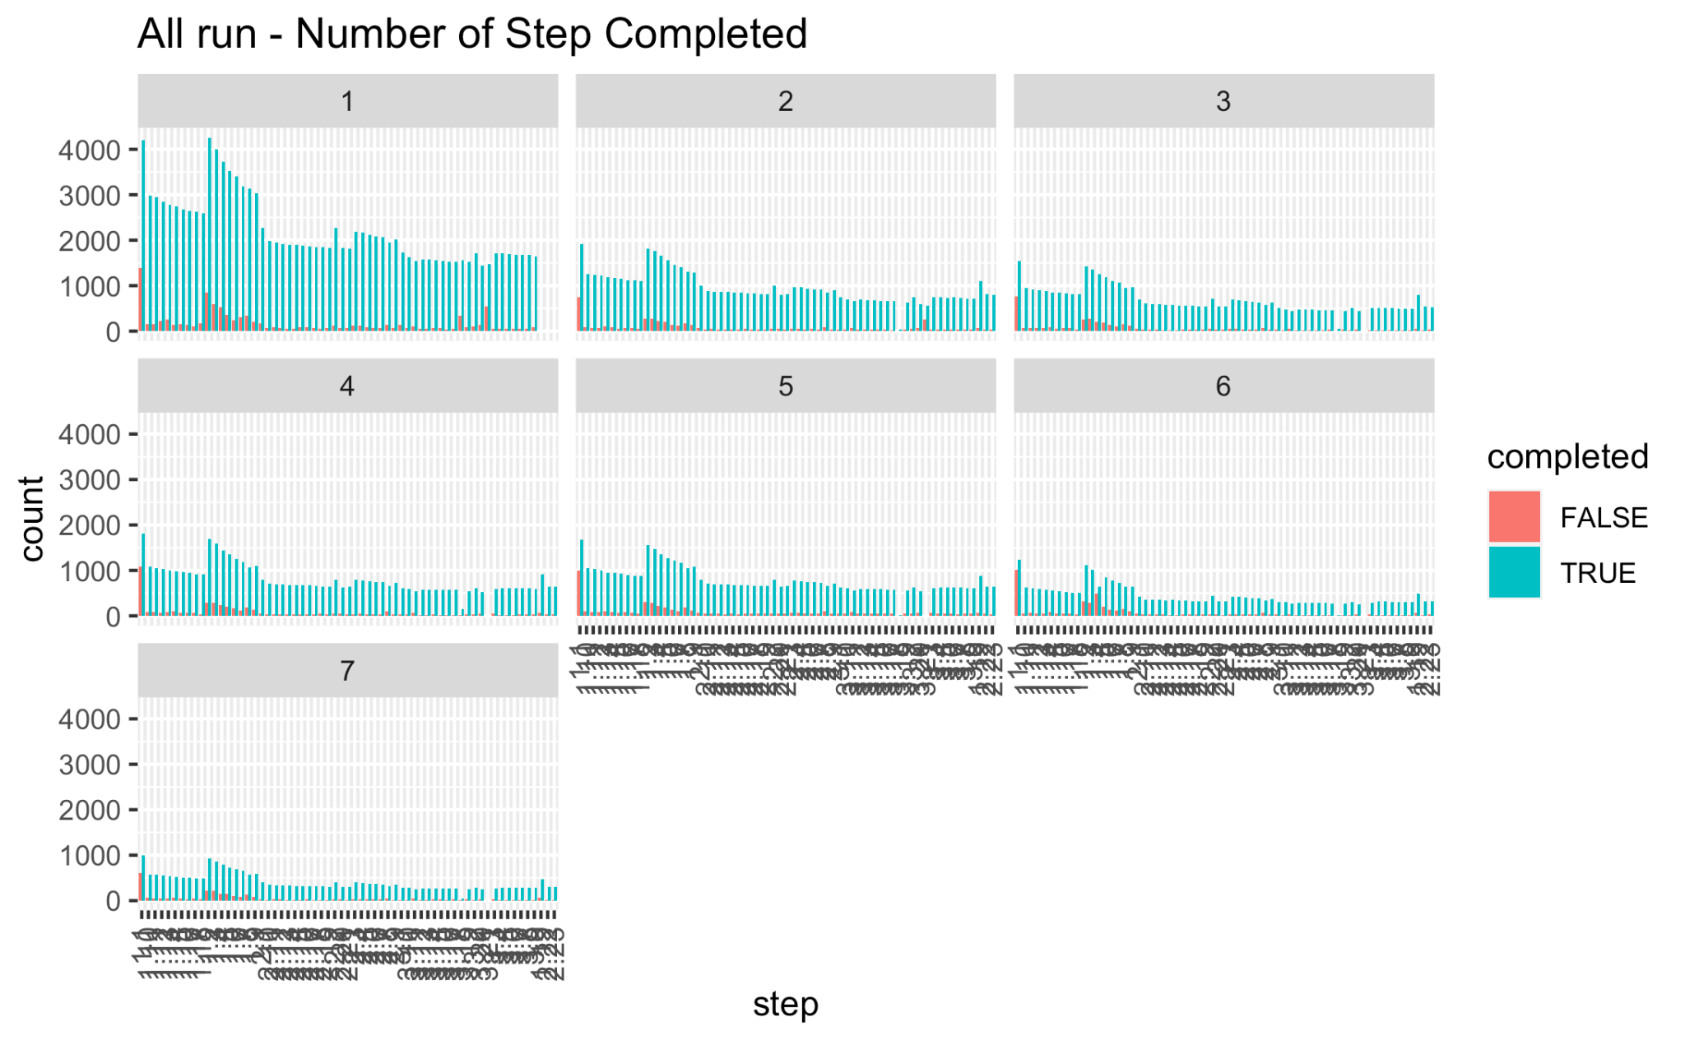
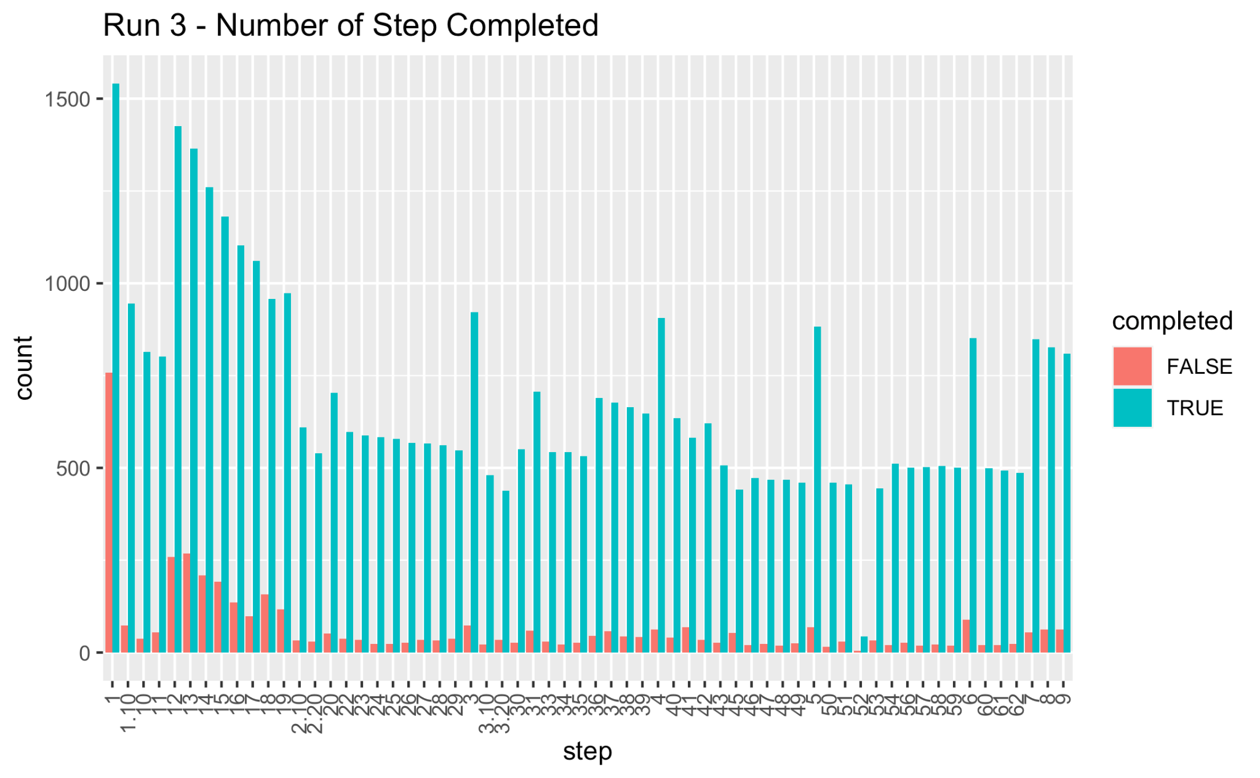
Step Activity

Slide 15
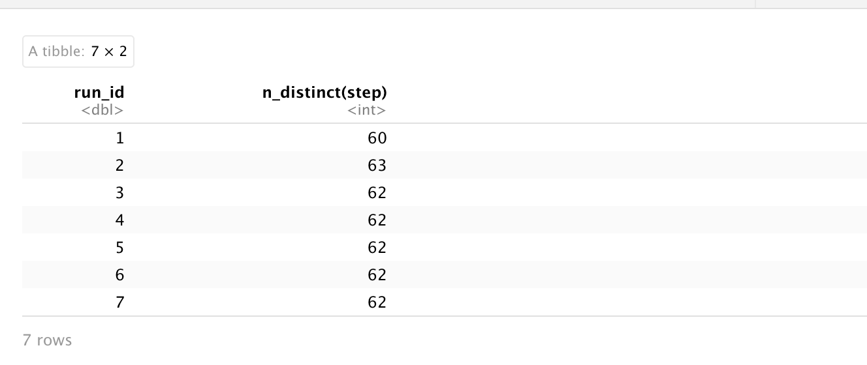
Step Activity

Slide 16
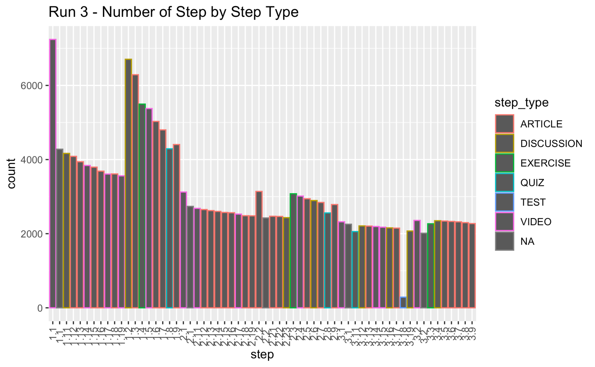
Step Activity
Notes:
map

Slide 17
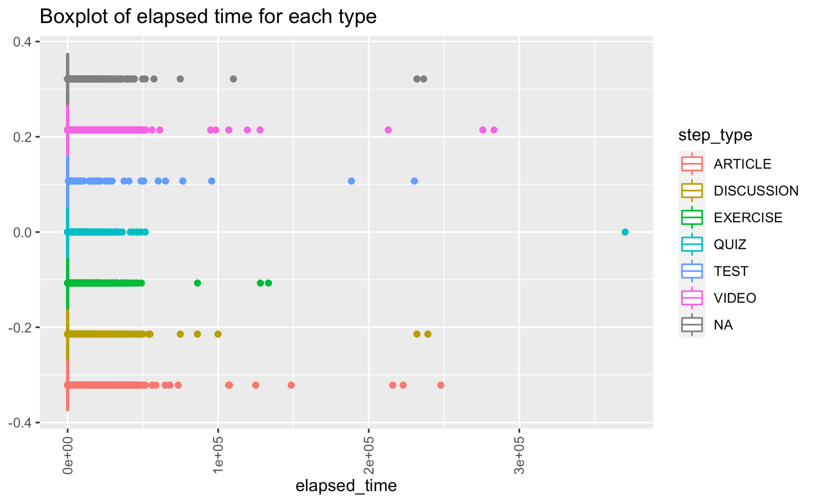
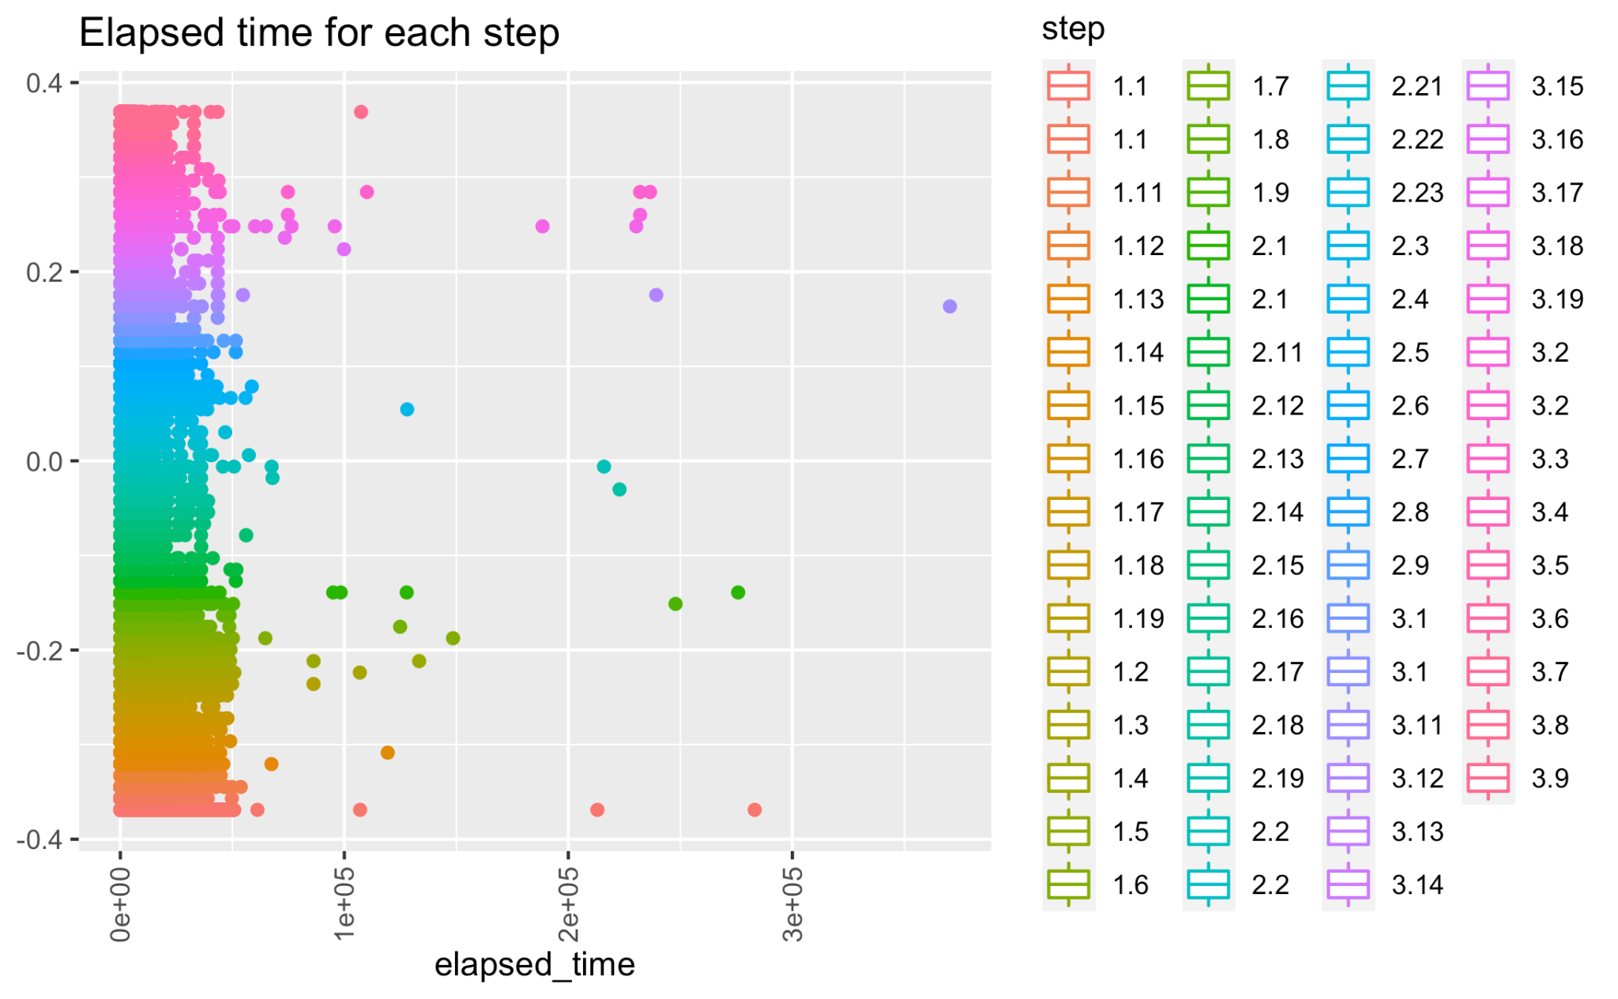
Reading Time

Slide 18
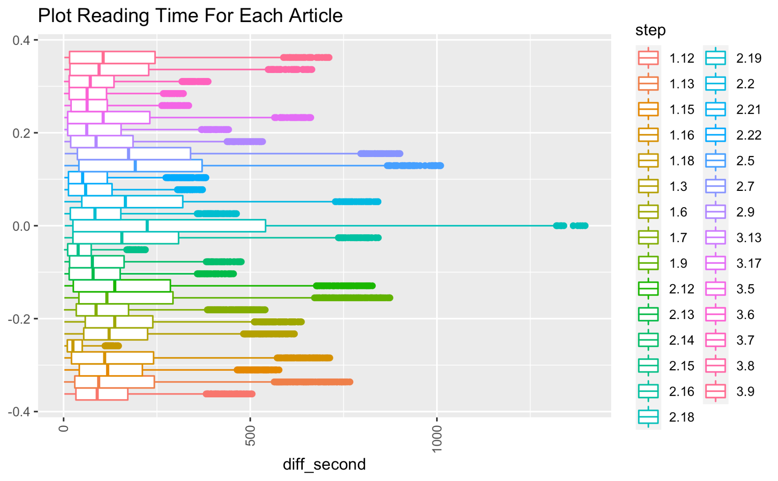
Reading Time

Slide 19
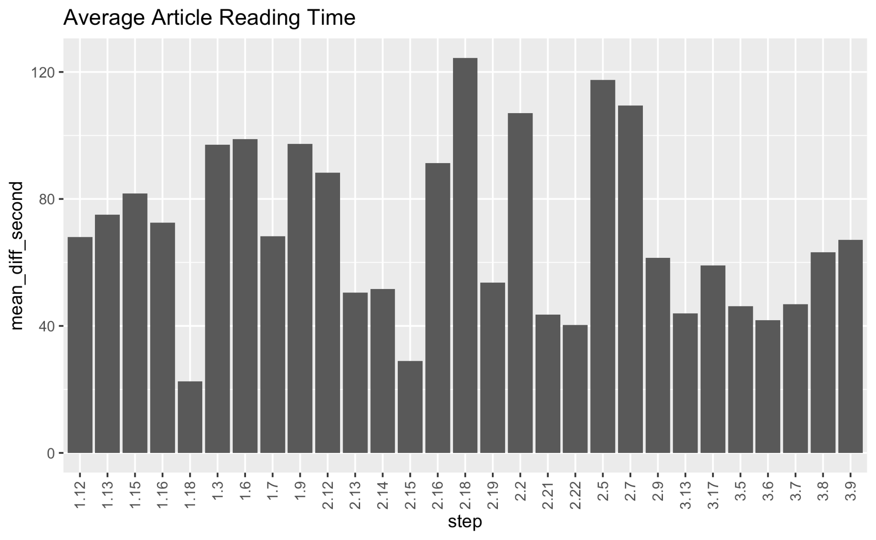
Average Article Reading Time

Slide 20
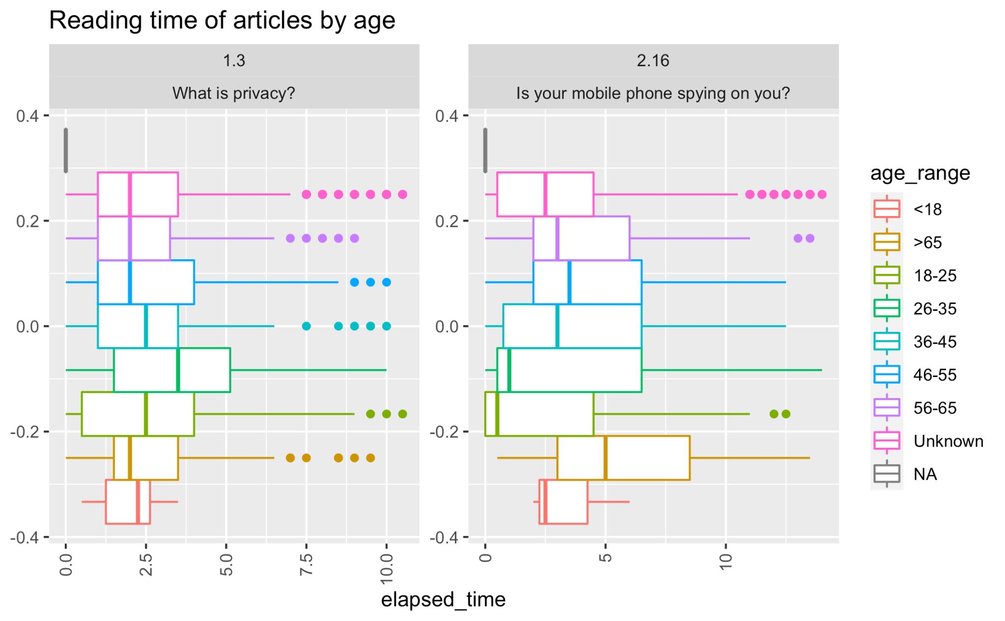
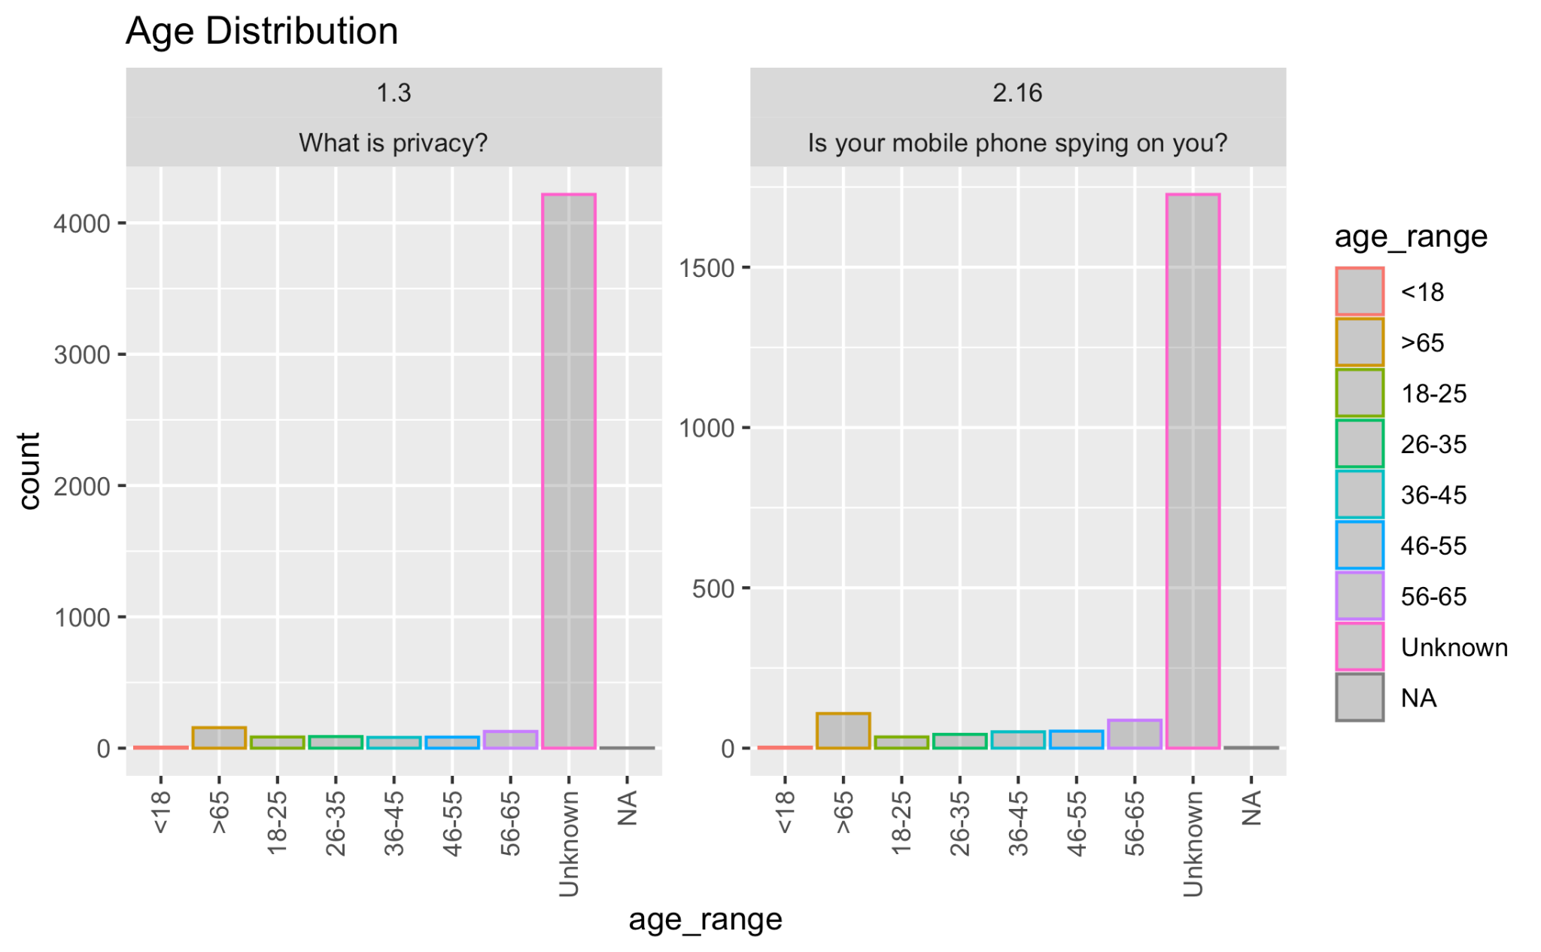
Age

Slide 21
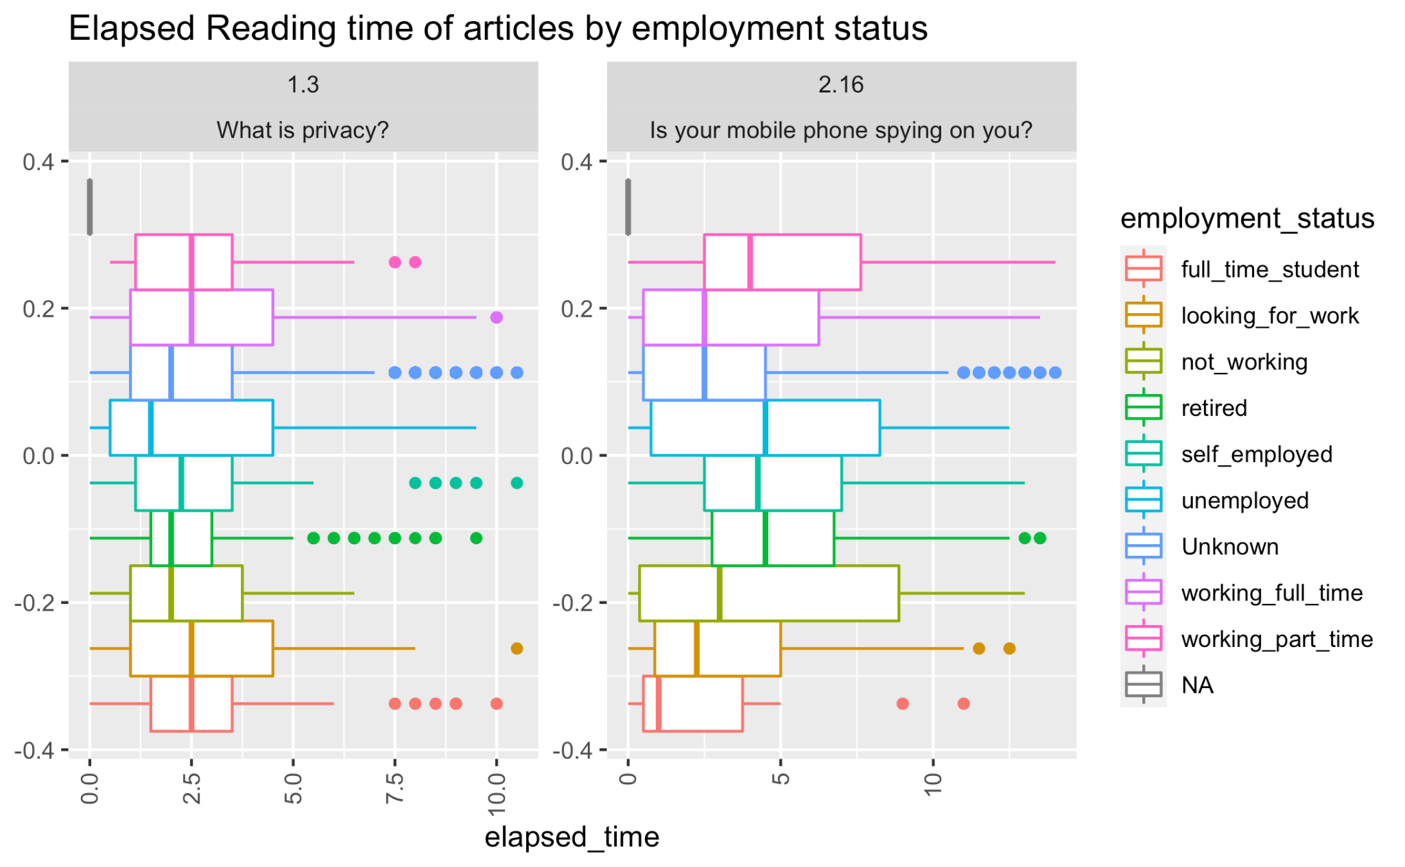
Employment Status

Slide 22
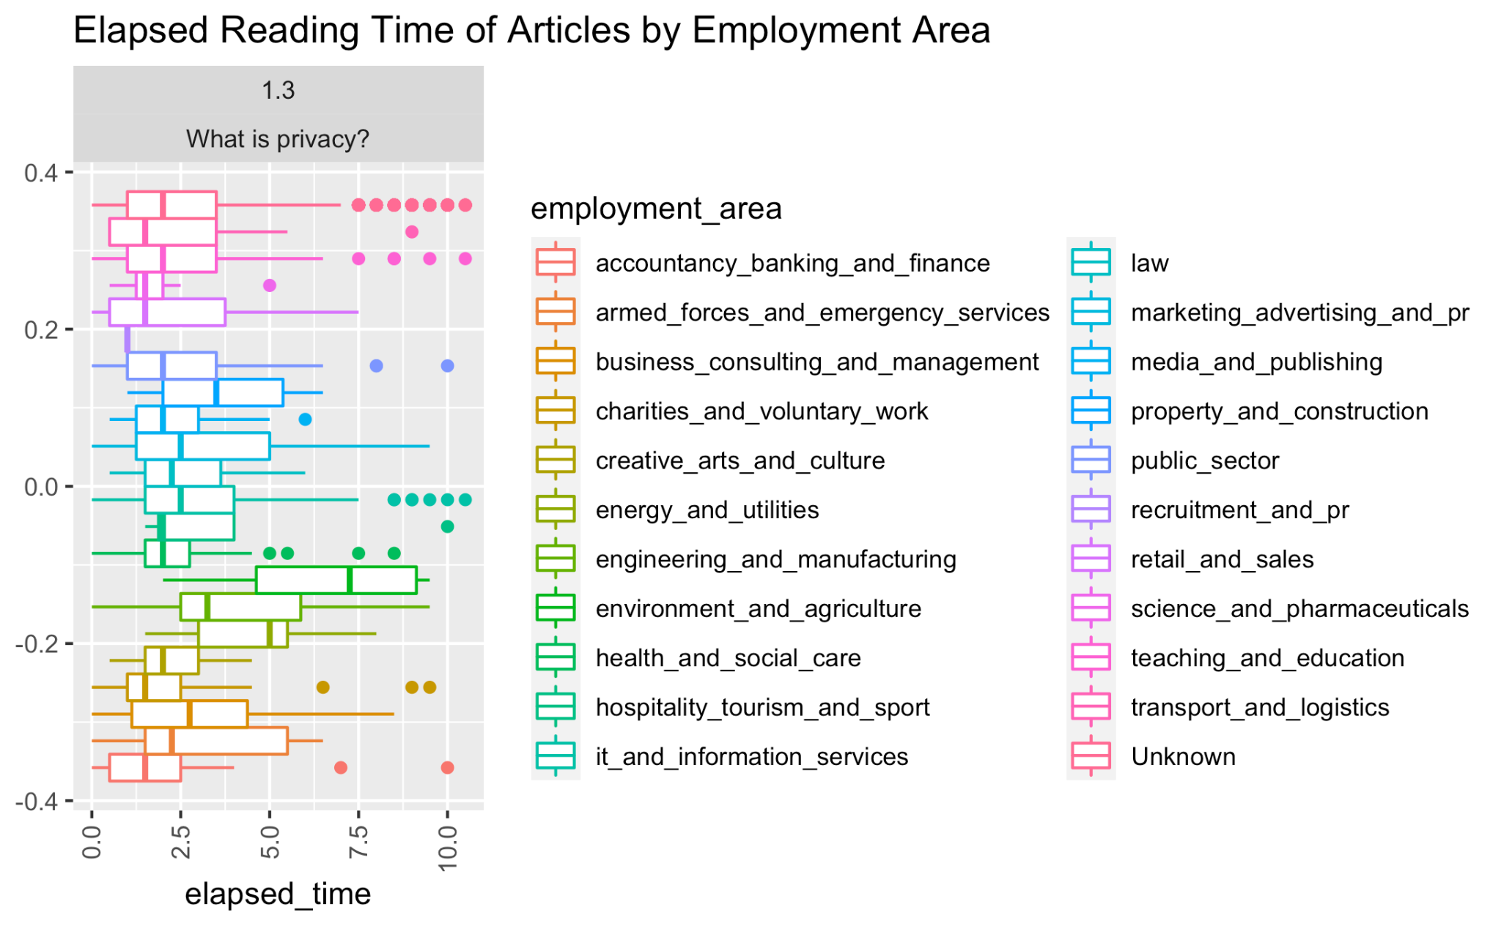
Employment Area

Slide 23
Model
Predict the estimated reading time

Slide 24
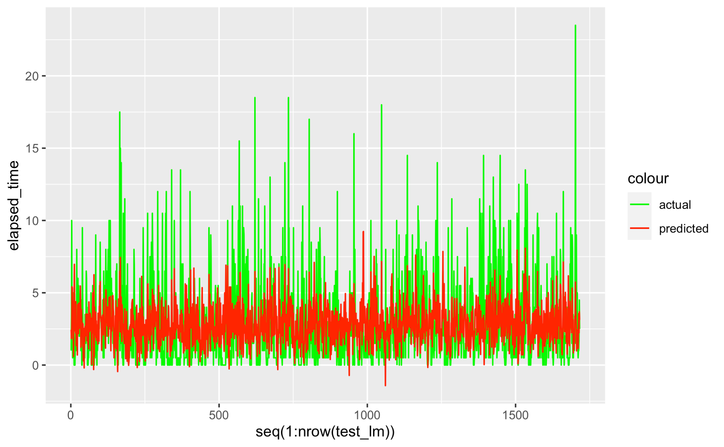
Linear Regression
RMSE: 2.60 min

Slide 25
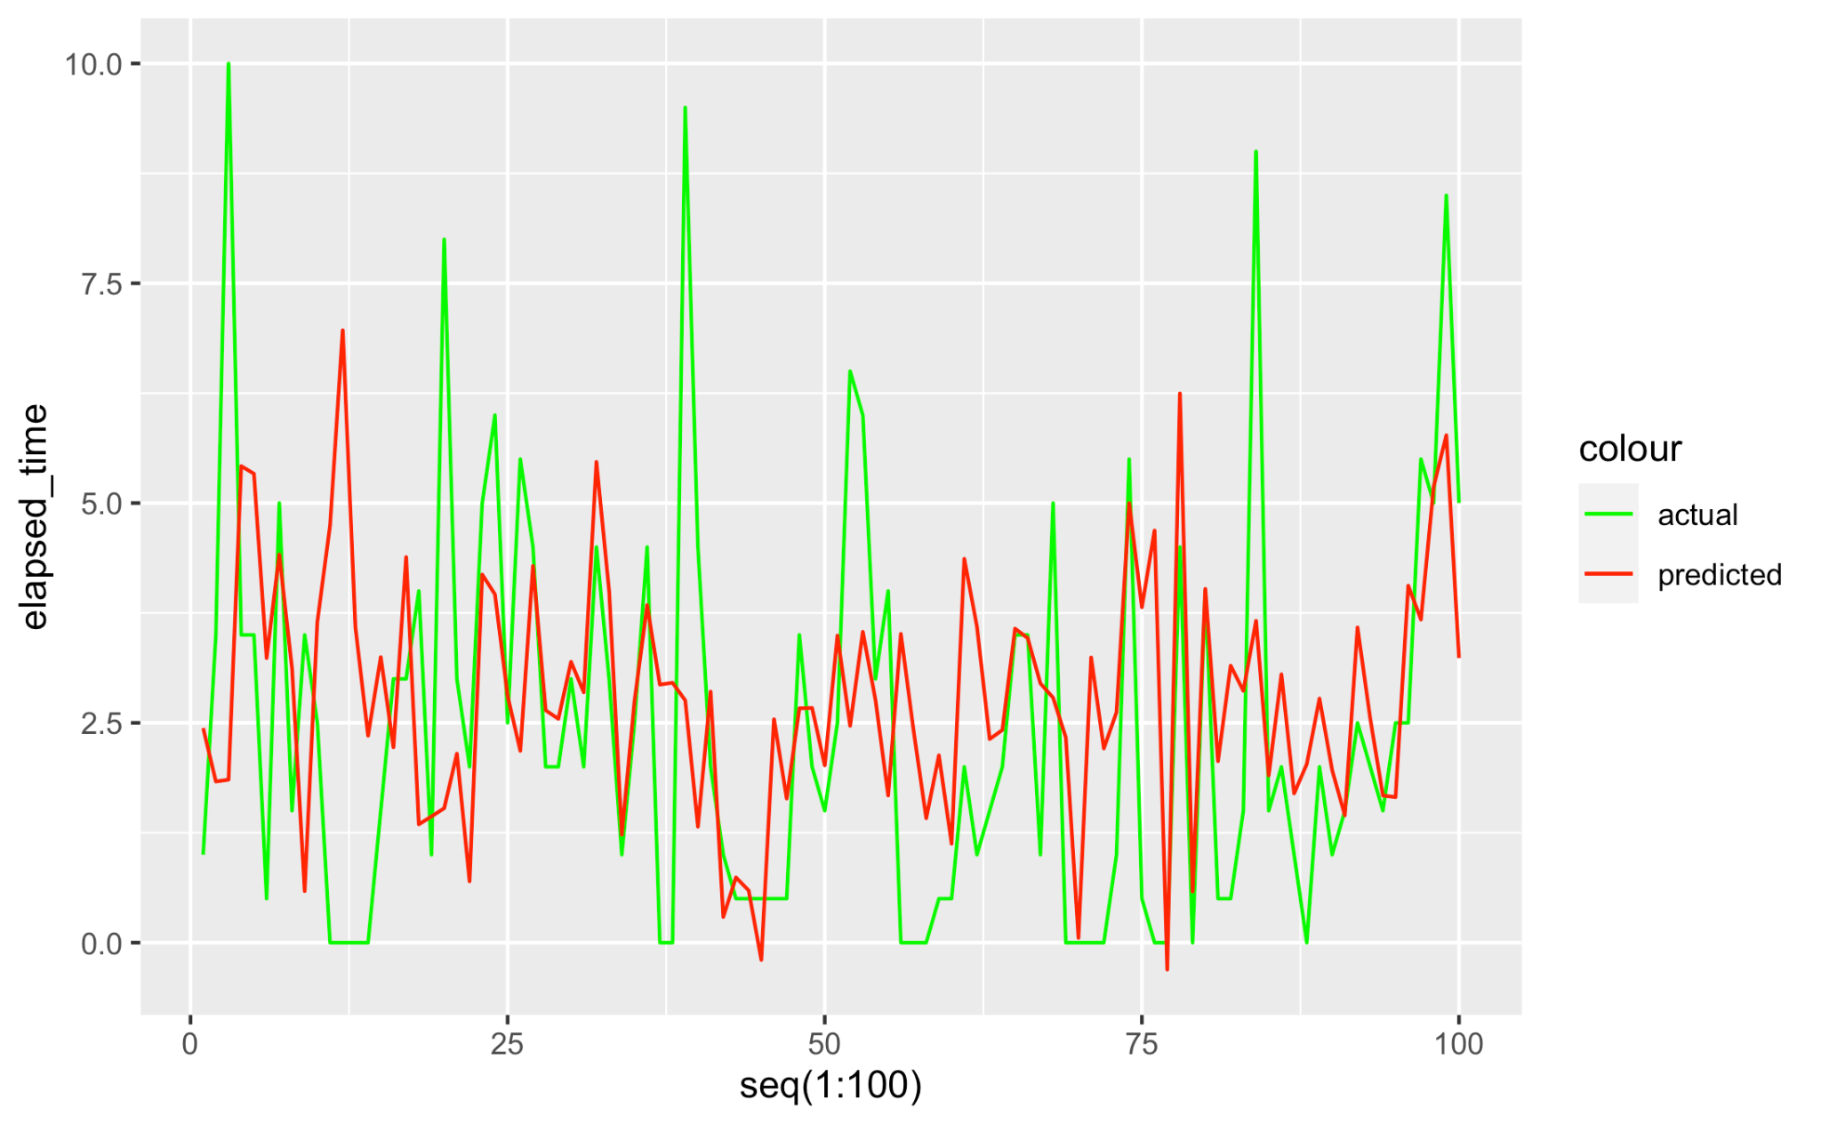
Linear Regression

